Slide 1
Recurrent Neural Networks
Lecturer: Eilam Shapira
NLP Course - Units 5+6 - Lecture Based on Amir Feder's slides & Stanford’s CS224n

Slide 2
Today’s Plan
We will briefly recap word embedding→sequence classification
Word2vec
GloVe
Sentence-level tasks/applications
We will then discuss LMs and why we need some sequential structure in NLP
We will then present Recurrent Neural Networks as a solution
But they will come with a problem - vanishing gradients
Finally, we will propose LSTMs as a solution

Slide 3
Word2vec – Forward Step
Vocabulary size
~450,000
Word vector dimension
300
Binary
Prediction
+/-

Slide 4
GloVe – Forward Step
Log Co-occurrence
Prediction
R
Vocabulary size
~450,000
Word vector dimension
300

Slide 5
Static Word Embedding – Result
Vocabulary size
~450,000
Word vector dimension
50/100/200/300

Slide 6
A sentence is more than a bunch of words
We learned how to represent words
We can just concatenate
But what will we lose?

Slide 7
Words now represent meaning
Vocabulary size
~450,000
Word vector dimension
300

Slide 8
Sentence = Concatenated Word Rep.

Slide 9
Sentence Representation

Slide 10
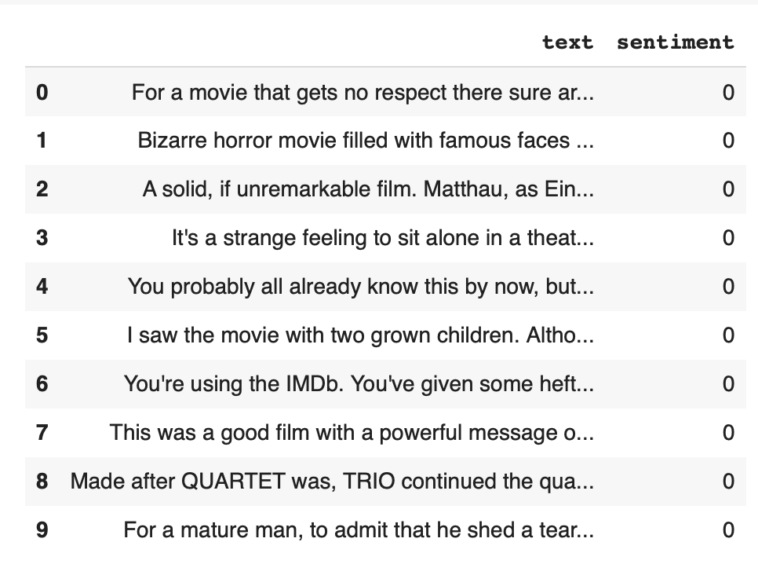
Sentiment Classification

Slide 11
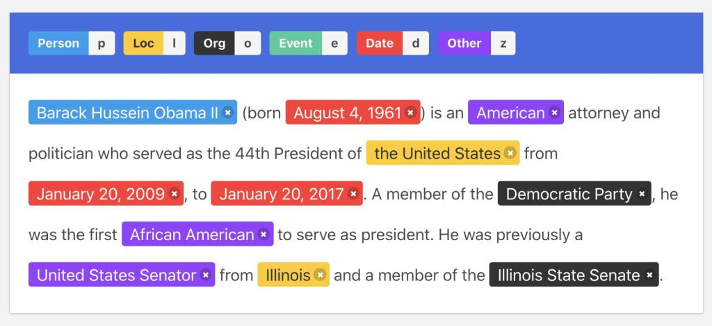
Named Entity Recognition

Slide 12
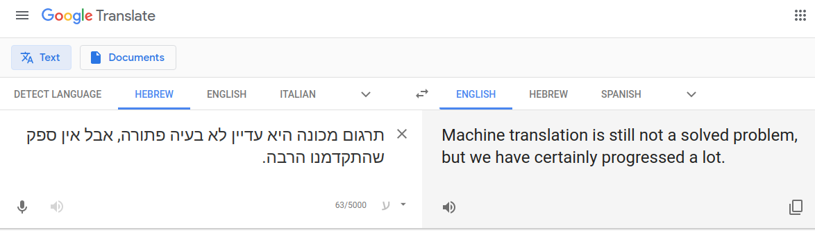

Machine Translation

Slide 13
Today’s Agenda
Sequence Classification + Applications
RNNs + Language Models
LSTM
Bidirectional and Multi-layer RNNs

Slide 14
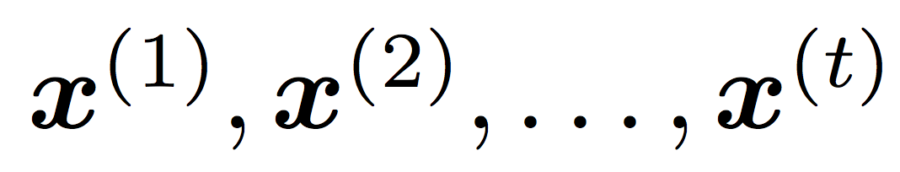
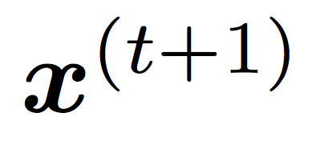
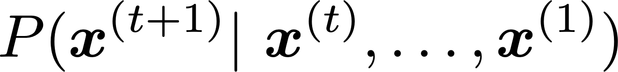

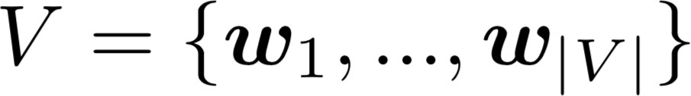
Language Modeling
Language Modeling is the task of predicting what word comes next
the students opened their
books
laptops
exams
minds
More formally: given a sequence of words
compute the probability distribution of the next word
,
:
where can be any word in the vocabulary
A system that does this is called a Language Model

Slide 15
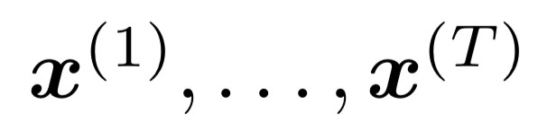
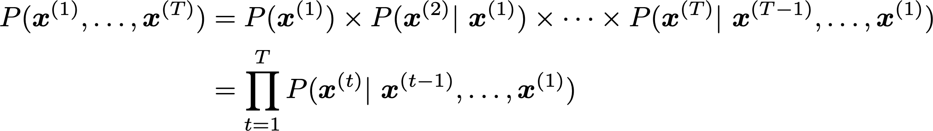
Language Modeling
You can also think of a Language Model as a system that assigns probability to a piece of text
For example, if we have some text , then the probability of this text (according to the Language Model) is:
This is what our LM provides

Slide 16
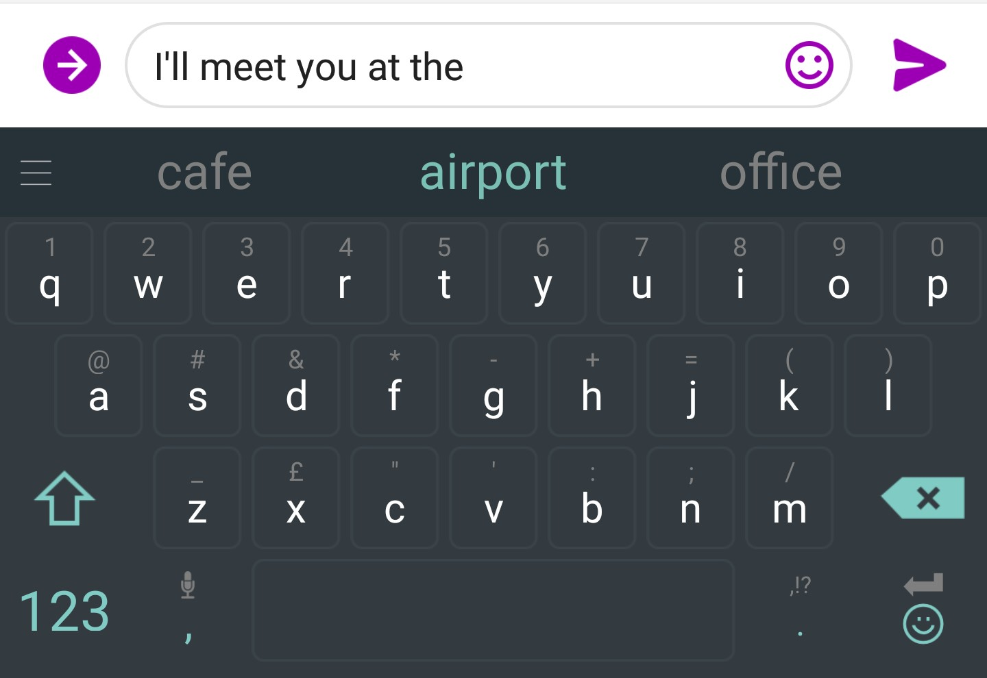
You use Language Models every day!

Slide 17

You use Language Models every day!

Slide 18
n-gram Language Models
the students opened their...
Question: How to learn a Language Model?
Answer (pre- Deep Learning): learn an n-gram Language Model!
Definition: A n-gram is a chunk of n consecutive words.
unigrams: “the”, “students”, “opened”, ”their”
bigrams: “the students”, “students opened”, “opened their”
trigrams: “the students opened”, “students opened their”
4-grams: “the students opened their”
Idea: Collect statistics about how frequent different n-grams are and use these to predict next word.

Slide 19
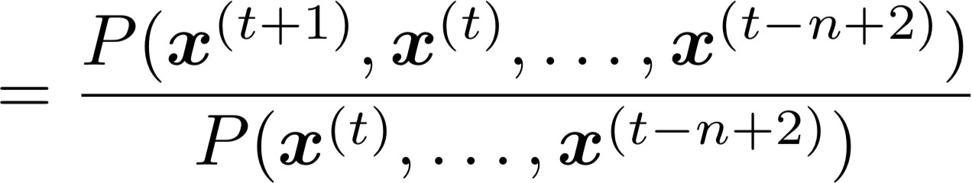
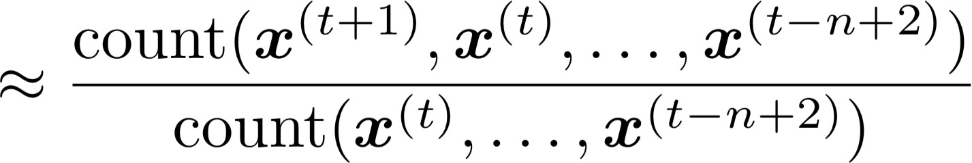
n-gram Language Models
First we make a Markov assumption: 𝑥^{($&')} depends only on the preceding n-1 words
n-1 words
(assumption)
prob of a n-gram
(definition of conditional prob)
prob of a (n-1)-gram
Question: How do we get these n-gram and (n-1)-gram probabilities?
Answer: By counting them in some large corpus of text!
(statistical approximation)

Slide 20
n-gram Language Models: Example
Suppose we are learning a 4-gram Language Model.
as the proctor started the clock, the students opened their
discard condition on this
For example, suppose that in the corpus:
“students opened their” occurred 1000 times
“students opened their books” occurred 400 times
🡪 P(books | students opened their) = 0.4
“students opened their exams” occurred 100 times
🡪 P(exams | students opened their) = 0.1

Slide 21
Sparsity Problems with n-gram Language Models
Sparsity Problem 1
Problem: What if “students opened their 𝑤” never occurred in data? Then 𝑤 has probability 0!
(Partial) Solution: Add small 𝛿 to the count for every 𝑤 ∈ 𝑉. This is called smoothing.
Sparsity Problem 2
Problem: What if “students opened their” never occurred in data? Then we can’t calculate probability for any 𝑤!
(Partial) Solution: Just condition on “opened their” instead.
This is called backoff.
Note: Increasing n makes sparsity problems worse.
Typically, we can’t have n bigger than 5.

Slide 22
Storage Problems with n-gram Language Models
Storage: Need to store count for all n-grams you saw in the corpus.
Increasing n or increasing corpus increases model size!

Slide 23
n-gram Language Models in practice
You can build a simple trigram Language Model over a
1.7 million word corpus (Reuters) in a few seconds on your laptop*
Business and financial news
today the ...
get probability distribution
company bank price italian emirate
0.153
0.153
Sparsity problem: not much granularity in the probability distribution
0.077
0.039
0.039
…
Otherwise, seems reasonable!
* Try for yourself: https://nlpforhackers.io/language-models/

Slide 24
Generating text with a n-gram Language Model
You can also use a Language Model to generate text
today the
condition
on this
get probability distribution
company | 0.153
bank | 0.153
price | 0.077
italian | 0.039
emirate | 0.039 …
sample

Slide 25
Generating text with a n-gram Language Model
You can also use a Language Model to generate text
today the price
condition
on this
get probability distribution
of | 0.308 | sample
for | 0.050
it | 0.046
to | 0.046
is | 0.031 …

Slide 26
Generating text with a n-gram Language Model
You can also use a Language Model to generate text
today the price of gold per ton , while production of shoe lasts and shoe industry , the bank intervened just after it considered and rejected an imf demand to rebuild depleted european stocks , sept 30 end primary 76 cts a share .
Surprisingly grammatical!
…but incoherent. We need to consider more than three words at a time if we want to model language well.
But increasing n worsens sparsity problem, and increases model size…

Slide 27
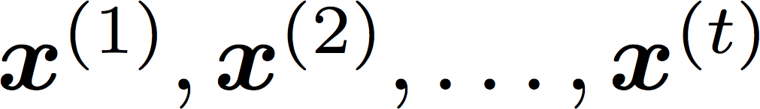

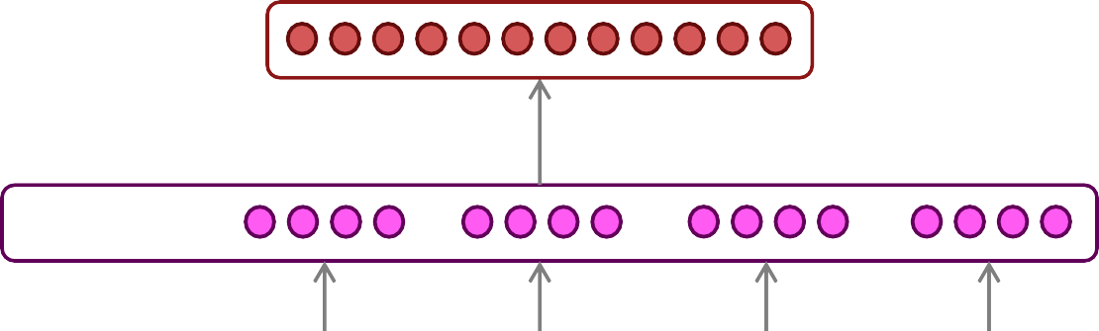




How to build a neural Language Model?
Recall the Language Modeling task:
Input: sequence of words
Output: prob dist of the next word
How about a window-based neural model?
We saw this applied to Named Entity Recognition in Lecture 2:
LOCATION
nightlife
in
Haifa
is amazing

Slide 28
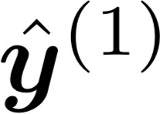
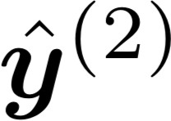
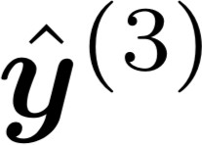
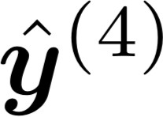
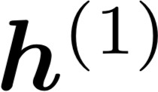
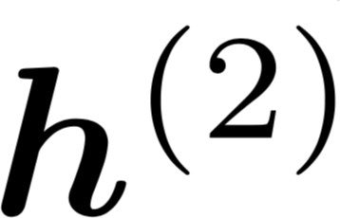
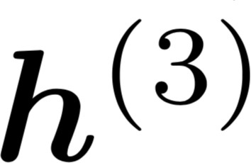
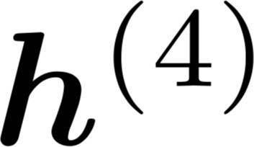





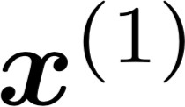
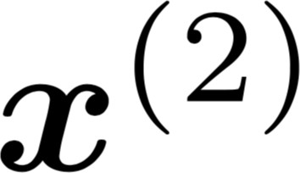
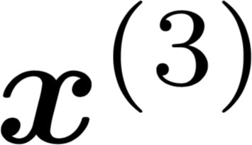
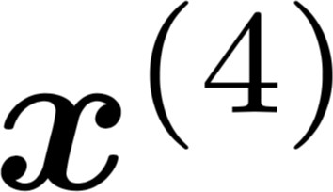
Recurrent Neural Networks (RNN)
A family of neural architectures
Core idea: Apply the same weights
𝑊 repeatedly
outputs (optional)
…
hidden states
…
input sequence (any length)
…

Slide 29
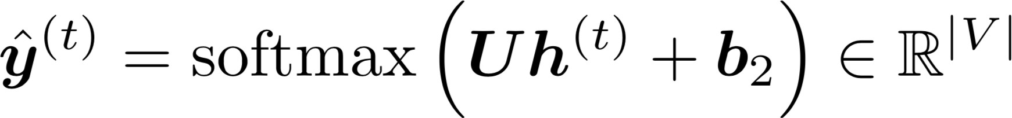

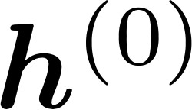
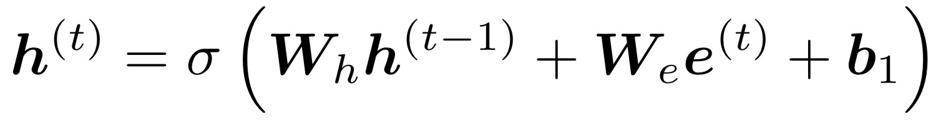




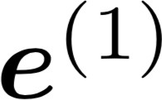

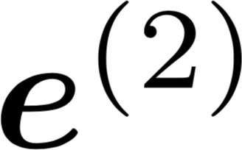
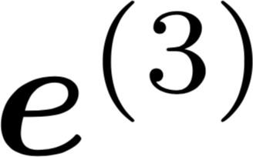

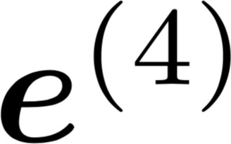




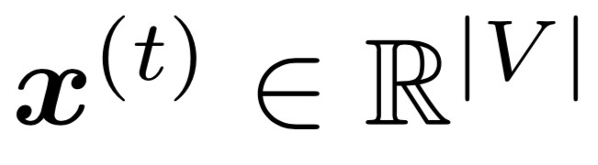
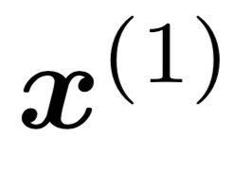
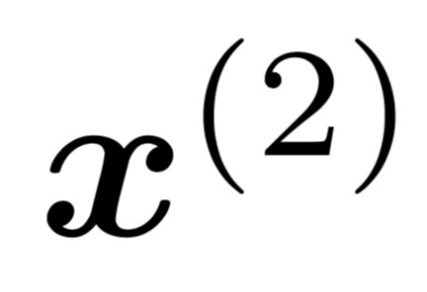
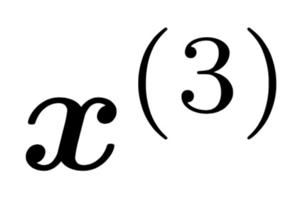
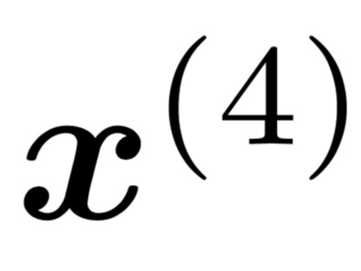
A Simple RNN Language Model
books
laptops
output distribution
a
zoo
hidden states
is the initial hidden state
word embeddings
words / one-hot vectors
the students
opened
their
Note: this input sequence could be much longer now!

Slide 30
RNN Language Models
books
laptops
RNN Advantages:
Can process any length input
Computation for step t can (in theory) use information from many steps back
Model size doesn’t increase for longer input context
Same weights applied on every timestep, so there is symmetry in how inputs are processed.
a
zoo
RNN Disadvantages:
Recurrent computation is slow
In practice, difficult to access information from many steps back
the students
opened
their

Slide 31
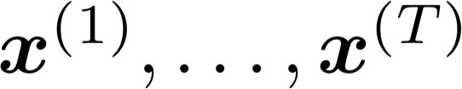
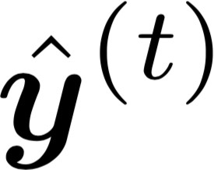
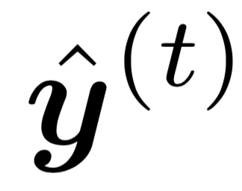
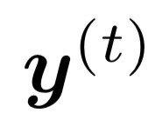
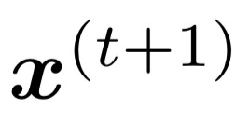
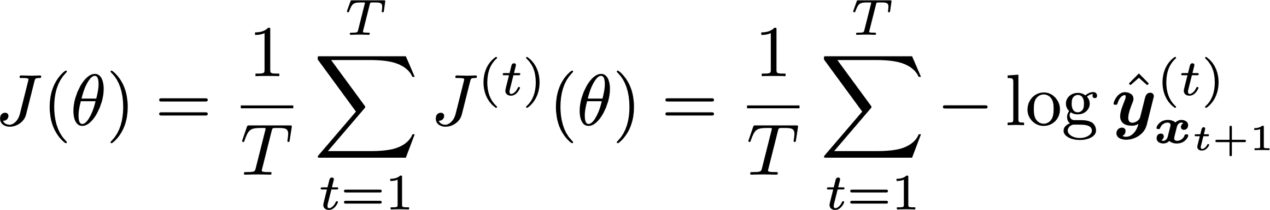
Training an RNN Language Model
Get a big corpus of text which is a sequence of words
Feed into RNN-LM; compute output distribution for every step t.
i.e. predict probability dist of every word, given words so far
Loss function on step t is cross-entropy between predicted probability distribution , and the true next word (one-hot for ):
Average this to get overall loss for entire training set:

Slide 32
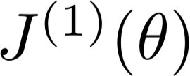
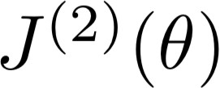
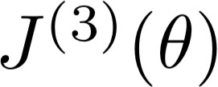
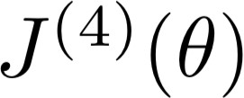



Training an RNN Language Model
= negative log prob of “students”
Loss
Predicted prob dists
…
Corpus
the
students
opened
their
exams
…

Slide 33
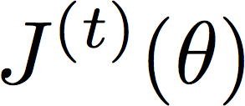
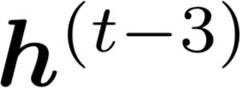







Backpropagation for RNNs
…
…
Question: What’s the derivative of
w.r.t. the repeated weight matrix ?
“The gradient w.r.t. a repeated weight is the sum of the gradient
w.r.t. each time it appears”
Answer:

Slide 34
Backpropagation for RNNs
…
…
Answer: Backpropagate over timesteps i=t,…,0, summing gradients as you go.
This algorithm is called “backpropagation through time” [Werbos, P.G., 1988, Neural Networks 1, and others]
Question: How do we calculate this?

Slide 35
Generating text with a RNN Language Model
Just like a n-gram Language Model, you can use a RNN Language Model to generate text by repeated sampling. Sampled output becomes next step’s input.
favorite
sample
season
sample
is
sample
spring
sample
…
my favorite
season
is
spring

Slide 36


Generating text with an RNN Language Model
You can train an RNN-LM on any kind of text, then generate text in that style.
RNN-LM trained on Harry Potter:
Source: https://medium.com/deep-writing/harry-potter-written-by-artificial-intelligence-8a9431803da6

Slide 37


Generating text with an RNN Language Model
You can train an RNN-LM on any kind of text, then generate text in that style.
RNN-LM trained on recipes:
Source: https://gist.github.com/nylki/1efbaa36635956d35bcc

Slide 38


Generating text with a RNN Language Model
You can train a RNN-LM on any kind of text, then generate text in that style.
RNN-LM trained on paint color names:
This is an example of a character-level RNN-LM (predicts what character comes next)
Source: http://aiweirdness.com/post/160776374467/new-paint-colors-invented-by-neural-network

Slide 39



Evaluating Language Models
The standard evaluation metric for Language Models is perplexity.
Normalized by number of words
Inverse probability of corpus, according to Language Model
This is equal to the exponential of the cross-entropy loss
:
Lower perplexity is better!

Slide 40

RNNs have greatly improved perplexity
n-gram model
Increasingly complex RNNs
Perplexity improves (lower is better)
Source: https://research.fb.com/building-an-efficient-neural-language-model-over-a-billion-words/

Slide 41
Why should we care about Language Modeling?
Language Modeling is a benchmark task that helps us measure our progress on understanding language
Language Modeling is a subcomponent of many NLP tasks, especially those involving generating text or estimating the probability of text:
Predictive typing
Speech recognition
Handwriting recognition
Spelling/grammar correction
Authorship identification
Machine translation
Summarization
Dialogue
etc.

Slide 42
Recap
Language Model: A system that predicts the next word
Recurrent Neural Network: A family of neural networks that:
Take sequential input of any length
Apply the same weights on each step
Can optionally produce output on each step
We’ve shown that RNNs are a great way to build a LM.
But RNNs are useful for much more!

Slide 43

RNNs can be used for tagging
e.g., part-of-speech tagging, named entity recognition
DT
JJ
NN
VBN
IN
DT
NN
the startled cat
knocked
over
the
vase

Slide 44



RNNs can be used for sentence classification
e.g., sentiment classification
positive
How to compute
sentence encoding?
Sentence encoding
overall
I
enjoyed
the
movie
a
lot

Slide 45
RNNs can be used for sentence classification
e.g., sentiment classification
positive
How to compute
sentence encoding?
Sentence encoding
Basic way:
Use final hidden state
Equals
overall
I
enjoyed
the
movie
a
lot

Slide 46
RNNs can be used for sentence classification
e.g., sentiment classification
positive
How to compute sentence encoding?
Sentence encoding
Usually better: Take element-wise max or mean of all hidden states
overall
I
enjoyed
the
movie
a
lot

Slide 47

RNNs can be used as an encoder module
e.g., question answering, machine translation, many other tasks!
Answer: German
Here the RNN acts as an encoder for the Question (the hidden states represent the Question). The encoder is part of a larger neural system.
Lots of neural
lots of neural
architecture
architectures
Context: Ludwig van Beethoven was a German composer and pianist. A crucial figure …
Question: what nationality was
Beethoven ?

Slide 48

RNN-LMs can be used to generate text
e.g., speech recognition, machine translation, summarization
RNN-LM
Input (audio)
what’s
the weather
conditioning
<START>
what’s the
This is an example of a conditional language model.
We’ll see Machine Translation in much more detail later.

Slide 49


The Problem of Vanishing Gradients

Slide 50
Problems with Vanishing and Exploding Gradients

Slide 51



Vanishing gradient intuition
chain rule!

Slide 52


Vanishing gradient intuition
chain rule!

Slide 53


Vanishing gradient intuition
chain rule!

Slide 54
Vanishing gradient intuition
Vanishing gradient problem: When these are small, the gradient signal gets smaller and smaller as it backpropagates further
What happens if these are small?

Slide 55
Why is vanishing gradient a problem?
Gradient signal from far away is lost because it’s much smaller than gradient signal from close-by.
So, model weights are updated only with respect to near effects, not long-term effects.

Slide 56
Effect of vanishing gradient on RNN-LM
LM task: When she tried to print her tickets, she found that the printer was out of toner. She went to the stationery store to buy more toner. It was very overpriced. After installing the toner into the printer, she finally printed her [MASK]
To learn from this training example, the RNN-LM needs to model the dependency between “tickets” on the 7th step and the target word “tickets” at the end.
But if gradient is small, the model can’t learn this dependency
So, the model is unable to predict similar long-distance dependencies at test time

Slide 57

Why is exploding gradient a problem?
If the gradient becomes too big, then the SGD update step becomes too big:
learning rate
gradient
This can cause bad updates: we take too large a step and reach a weird and bad parameter configuration (with large loss)
You think you’ve found a hill to climb, but suddenly you’re in Iowa
In the worst case, this will result in Inf or NaN in your network (then you have to restart training from an earlier checkpoint)

Slide 58

Gradient clipping: solution for exploding gradient
Gradient clipping: if the norm of the gradient is greater than some threshold, scale it down before applying SGD update
Intuition: take a step in the same direction, but a smaller step
In practice, remembering to clip gradients is important, but exploding gradients are an easy problem to solve

Slide 59

How to fix the vanishing gradient problem?
The main problem is that it’s too difficult for the RNN to learn to preserve information over many timesteps.
In a vanilla RNN, the hidden state is constantly being rewritten
How about a RNN with separate memory?

Slide 60
Today’s Agenda
Sequence Classification + Applications
RNNs + Language Models
LSTM
Bidirectional and Multi-layer RNNs

Slide 61



Long Short-Term Memory RNNs (LSTMs)
A type of RNN proposed by Hochreiter and Schmidhuber in 1997 as a solution to the vanishing gradients problem.
On step t, there is a hidden state and a cell state
Both are vectors length n
The cell stores long-term information
The LSTM can read, erase, and write information from the cell
The cell becomes conceptually rather like RAM in a computer
The selection of which information is erased/written/read is controlled by three corresponding gates
The gates are also vectors length n
On each timestep, each element of the gates can be open (1), closed (0), or somewhere in-between
The gates are dynamic: their value is computed based on the current context

Slide 62


Long Short-Term Memory (LSTM)
We have a sequence of inputs 𝑥^{(")}, and we will compute a sequence of hidden states ℎ^{(")} and cell states
𝑐^{(")}. On timestep t:
Sigmoid function: all gate values are between 0 and 1
Forget gate: controls what is kept vs forgotten, from previous cell state
Input gate: controls what parts of the new cell content are written to cell
Output gate: controls what parts of cell are output to hidden state
New cell content: this is the new content to be written to the cell
All these are vectors of same length n
Cell state: erase (“forget”) some content from last cell state, and write (“input”) some new cell content
Hidden state: read (“output”) some content from the cell
Gates are applied using element-wise (or Hadamard) product: ⊙

Slide 63


Long Short-Term Memory (LSTM)
You can think of the LSTM equations visually like this:
Source: http://colah.github.io/posts/2015-08-Understanding-LSTMs/

Slide 64

Long Short-Term Memory (LSTM)
You can think of the LSTM equations visually like this:
Write some new cell content
The + sign is the secret!
Forget some cell content
c_{t}
c
^{c}t-1
t
f
i_{t}
o_{t}
Output some cell content to the hidden state
Compute the forget gate
t
~_{c}
t
^{h}t-1
h_{t}
Compute the input gate
Compute the new cell content
Compute the output gate
Source: http://colah.github.io/posts/2015-08-Understanding-LSTMs/

Slide 65
How does LSTM solve vanishing gradients?
The LSTM architecture makes it easier for the RNN to preserve information over many timesteps
e.g., if the forget gate is set to 1 for a cell dimension and the input gate set to 0, then the information of that cell is preserved indefinitely.
In contrast, it’s harder for a vanilla RNN to learn a recurrent weight matrix W_{h} that preserves info in the hidden state
In practice, you get about 100 timesteps rather than about 7
LSTM doesn’t guarantee that there is no vanishing/exploding gradient, but it does provide an easier way for the model to learn long-distance dependencies

Slide 66
LSTMs: real-world success
In 2013–2015, LSTMs started achieving state-of-the-art results
Successful tasks include handwriting recognition, speech recognition, machine translation, parsing, and image captioning, as well as language models
LSTMs became the dominant approach for most NLP tasks
Now (2021), other approaches (e.g., Transformers) have become dominant for many tasks
For example, in WMT (a Machine Translation conference + competition):
In WMT 2016, the summary report contains “RNN” 44 times
In WMT 2019: “RNN” 7 times, ”Transformer” 105 times

Slide 67
Today’s Agenda
Sequence Classification + Applications
RNNs + Language Models
LSTM
Bidirectional and Multi-layer RNNs

Slide 68

Bidirectional and Multi-layer RNNs: motivation
Task: Sentiment Classification
We can regard this hidden state as a representation of the word “terribly” in the context of this sentence. We call this a contextual representation.
positive
Sentence encoding
These contextual representations only contain information about the left context (e.g. “the movie was”).
What about right
context?
In this example, “exciting” is in the right context and this modifies the meaning of “terribly” (from negative to positive)
Element-wise mean/max
element-wise mean/max
the
movie was
terribly
exciting
!

Slide 69

Bidirectional RNNs
This contextual representation of “terribly” has both left and right context!
Concatenated hidden states
Backward RNN
Forward RNN
the
movie
^{was terribly}
exciting
!

Slide 70

Bidirectional RNNs
This is a general notation to mean “compute one forward step of the RNN” – it could be a vanilla, LSTM or GRU computation.
On timestep t:
Forward RNN
Backward RNN
Concatenated hidden states
Generally, these two RNNs have separate weights
We regard this as “the hidden state” of a bidirectional RNN. This is what we pass on to the next parts of the network.

Slide 71

Bidirectional RNNs: simplified diagram
the
movie was
terribly
exciting
!
The two-way arrows indicate bidirectionality and the depicted hidden states are assumed to be the concatenated forwards+backwards states

Slide 72
Bidirectional RNNs
Note: bidirectional RNNs are only applicable if you have access to the entire input sequence
They are not applicable to Language Modeling, because in LM you only have left context available.
If you do have entire input sequence (e.g., any kind of encoding), bidirectionality is powerful (you should use it by default).
For example, BERT (Bidirectional Encoder Representations from Transformers) is a powerful pretrained contextual representation system built on bidirectionality.
But more about transformers next week

Slide 73
Multi-layer RNNs
RNNs are already “deep” on one dimension (they unroll over many timesteps)
We can also make them “deep” in another dimension by applying multiple RNNs – this is a multi-layer RNN.
This allows the network to compute more complex representations
The lower RNNs should compute lower-level features and the higher RNNs should compute higher-level features.
Multi-layer RNNs are also called stacked RNNs.

Slide 74

Multi-layer RNNs
The hidden states from RNN layer i
are the inputs to RNN layer i+1
RNN layer 3
RNN layer 2
RNN layer 1
the
movie
^{was terribly}
exciting
!

Slide 75
Multi-layer RNNs in practice
High-performing RNNs are often multi-layer (but aren’t as deep as convolutional or feed-forward networks)
For example: In a 2017 paper, Britz et al find that for Neural Machine Translation, 2 to 4 layers is best for the encoder RNN, and 4 layers is best for the decoder RNN
Usually, skip-connections/dense-connections are needed to train deeper RNNs (e.g., 8 layers)
Transformer-based networks (e.g., BERT) are usually deeper, like 12 or 24 layers.
You will learn about Transformers later; they have a lot of skipping-like connections

